Slide 1

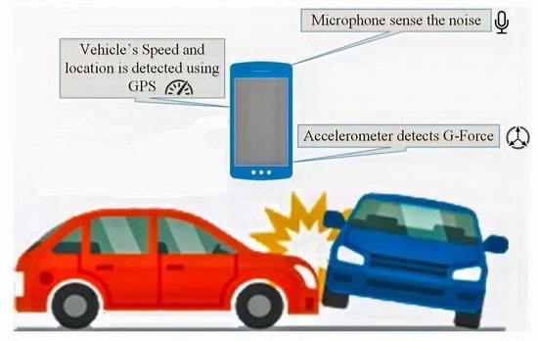
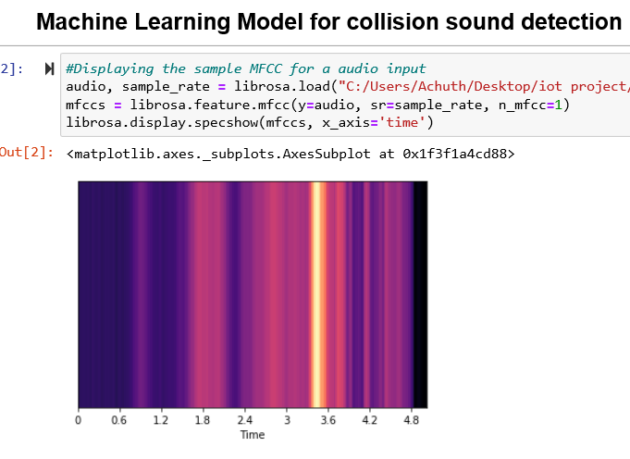
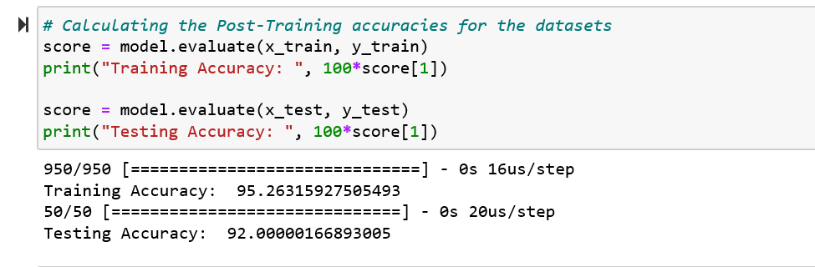
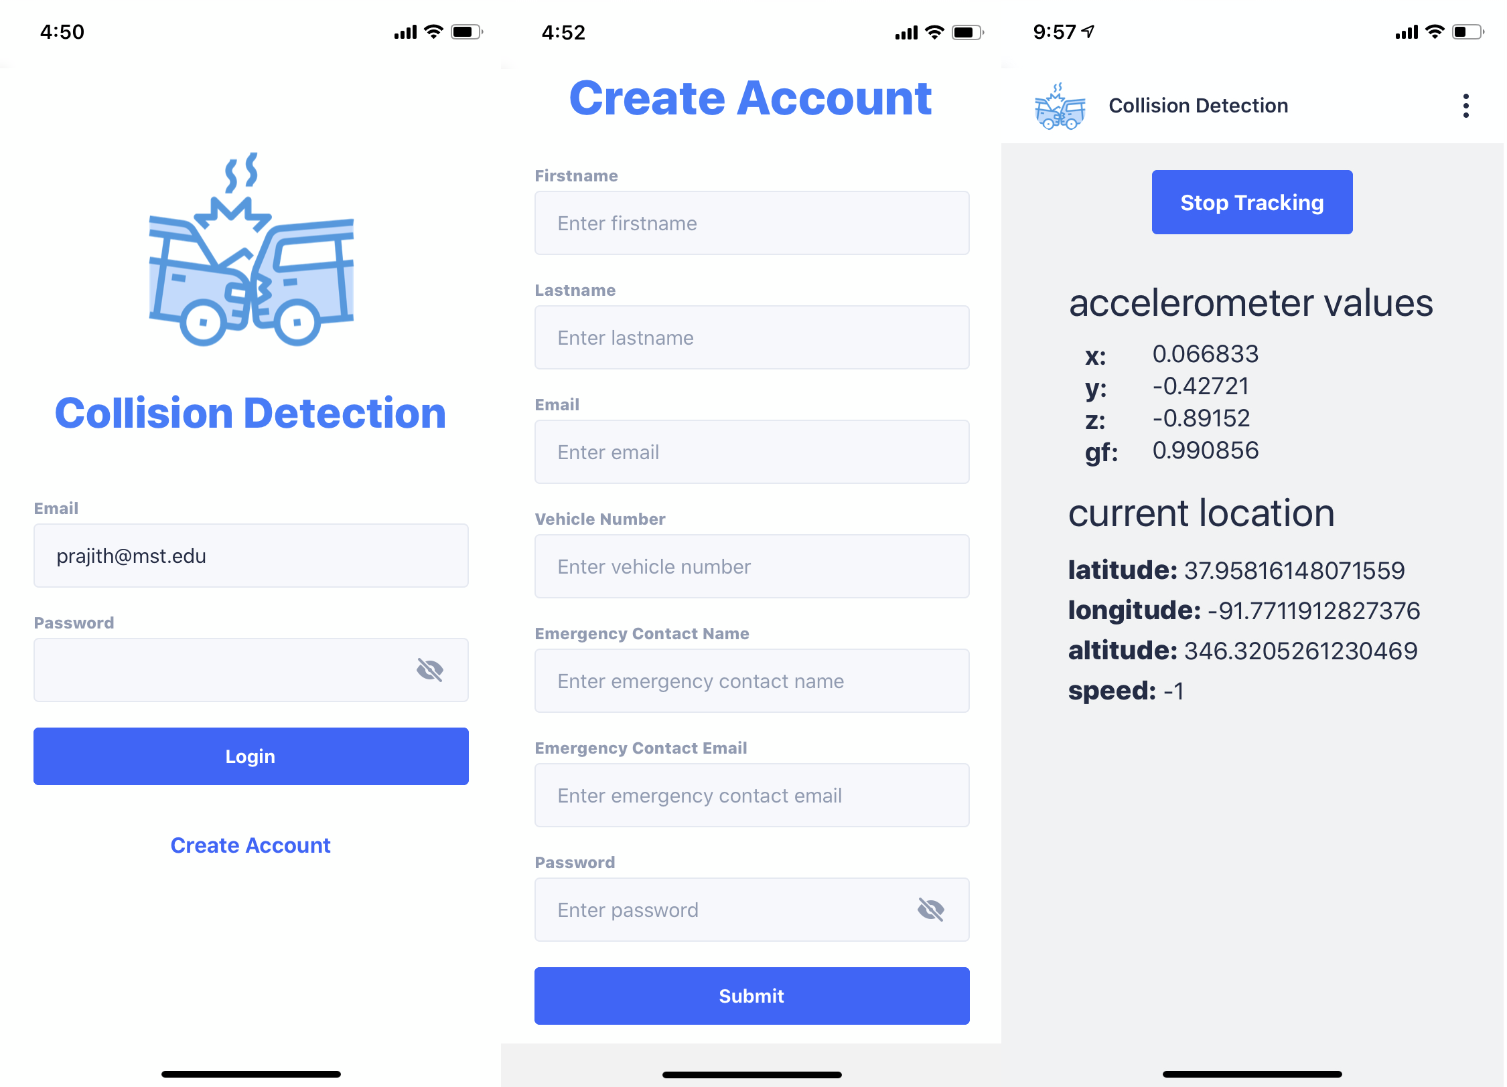
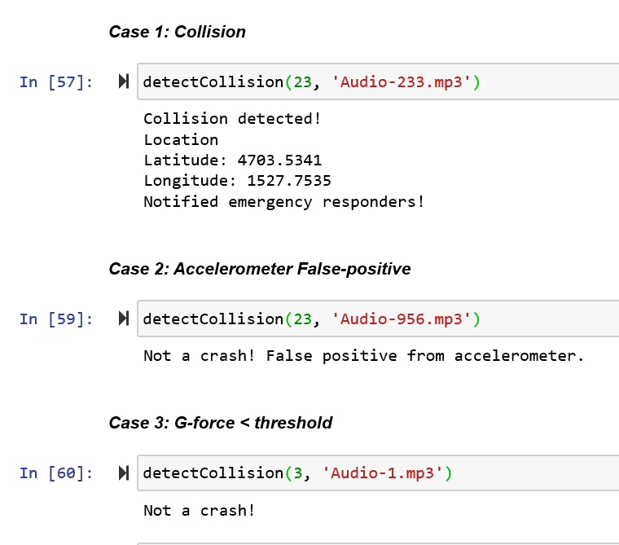
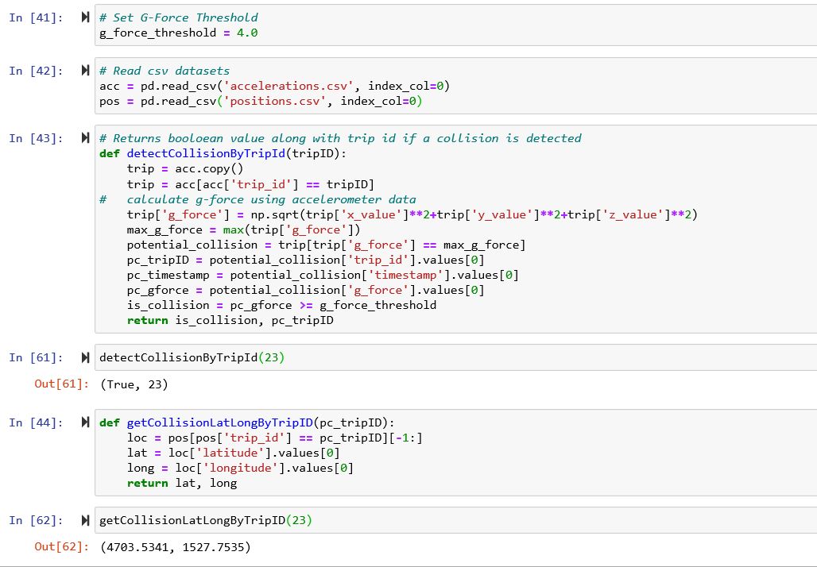
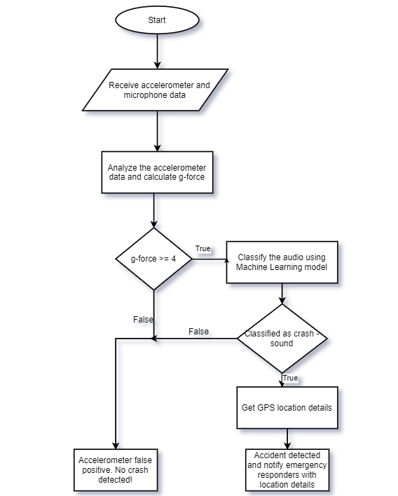
Anil Kumar Reddy Kodela (ak4mg@mst.edu ), Prajith Sai Sabbani (psdf5@mst.edu)
Smart Collision Detection using Machine Learning
Computer Science Department, Missouri S&T
Abstract
Implementation details
Module 2: Machine Learning Model
We built a Machine Learning model using the Python’s Keras deep learning API. A Sequential model with three layered architecture with the following approach was used:
Read all the audio files using Python’s Librosa package and create Mel-frequency cepstral coefficients (MFCC). In simple words, MFCC of a signal are a set of features that concisely describe the overall shape of the spectral envelope.
Create a DataFrame with the generated MFCC data.
We split the dataset into train and test data in 90% and 10% proportions respectively.
Limitations
According to Global status report by WHO (2018), nearly 1.35 million people die each year due to road accidents. To put things into perspective, for every 24 seconds, someone dies on the road somewhere in the world. If we can detect these accidents early and contact emergency responders, chances are, we can save a lot of lives. That’s exactly where our proposed system comes into picture. Using sensors such as accelerometer embedded into the smartphones, we detect vehicle collision and notify emergency responders with basic information such as name and vehicle number. Besides, to improve the accuracy, we also propose utilizing a ML model to analyze microphone data alongside accelerometer data to improve the accuracy of collision detection.
The proposed system can be divided into two modules. Module 1 includes developing a mobile application for collection data from the on-board sensors. Module 2 includes processing and classification of the data collected. We leverage a Machine Learning model in tandem with a neural network for classification.
Since the data is continuously retrieved from the mobile sensors the phone battery drains fast.
Data needs to be continuously collected and sent to server for processing. So, if user does not have an active internet connection the application will not be able to detect a collision.
If the mobile phone is not calibrated properly it may lead to false positives in g-force calculation.
Conclusion
We have trained our machine learning model with a real-time dataset which has 1000 audio files. It contains 900 crash sounds and 100 non-crash sounds. Non-crash sounds include tire-skidding, music, horn sounds etc. The proposed model has 95% training accuracy and 92% testing accuracy. Different possible test-cases have been tested and results are as expected. Multiple scenarios are tested to make sure the application detects the actual collisions and not false positives.
Module 1: Mobile Application
The application is developed using React Native, which offers cross-platform deployment. In other words, we write code once and issue separate builds for both Android and iOS. Following are a few key third-party libraries used for development:
react-native-cli to setup the project
Xcode for generating iOS build
react-navigation for navigating between the screens
react-native-sensors for capturing sensor information
react-native-community/geolocation for capturing the location data
ui-kitten for developing UI components
Introduction
Users download the application from App Store/Play Store and create an account by providing basic information such as their name, vehicle number, and nominate an emergency contact. Once the registration is finished, every time the user is about to go for a ride, he/she will have to click a button from the home page of the application to start tracking. Accelerometer data alongside GPS and microphone data will be continuously sent to the server for detecting collisions. If a collision is detected, emergency responders will be notified with the vehicle number and location co-ordinates.
Now we develop a Sequential Neural Network model using the Keras API. We used Keras with Tensorflow backend.
The reason behind using Tensorflow backend is, it is open source, free, and uses the distributed computing model which makes it ideal for real-time large datasets.
After the Model has been built we need to compile it.
Train the model using the training dataset and evaluate the model accuracy using the training and test dataset.
The model has been built, compiled and evaluated. It’s now time to input a sample audio file to see how it will be classified.
Design
Experimental Results
Acknowledgements
Once the application starts collecting the sensor data, it will be sent to the server where g-force is calculated using the following formula:
G-force = sqrt(x ^ 2 + y ^ 2 + z ^ 2)
After considering multiple scenarios a threshold of 4 has been set for the g-force. If the g-force exceeds the threshold, we call the machine learning model with the collision sound to classify if it is a crash or non-crash sound. If the Machine Learning model classifies it as a crash sound we confirm it is a collision and emergency responders are notified along with the vehicle and location details.
The experimental results were quite satisfactory. We have conducted experiments on the machine learning model using the experimetal_data dataset and the accuracy was 93%. We tried different epochs for training the Machine learning model and we finally arrived at a epoch value of 30. Creating the MFFC’s took some time but once the MFFC’s are created and we have the features for all the audio files. The training and running time for the Machine Learning model was fairly fast .
Crash sound dataset has been downloaded from the YouTube channel “Car Crash Time” https://www.youtube.com/user/CarCrashesTime/videos and each audio has been cropped to 5 seconds.
Accelerometer and positions dataset are downloaded from https://zenodo.org/record/820576#.XsBXKS-z3GI

